Slide 1
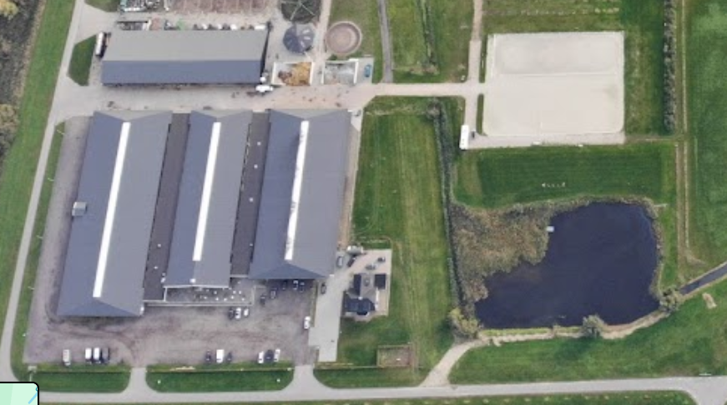

SELEVIA HOEVE, KOOIKE 2, 4251 NE WERKENDAM, KCM NVAI, 6 JULI 2024
PARKING
X
ENTRANCE
ENTRY OF DOGS BETWEEN 08:00 – 09:30 HR.

